Slide 1
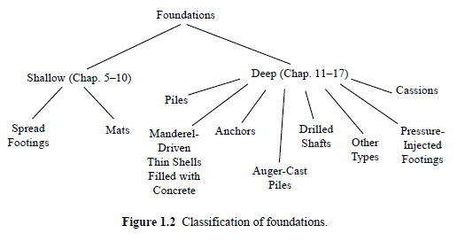
Types of Foundations
remember that we classified the foundations in two broad categories:

Slide 2
Types of Deep Foundations
we can divide in to two main types:
piles: prefabricated long foundations driven deep into the ground.
drilled shafts: deep foundations constructed by drilling a hole (usually cylindrical) into the ground, inserting reinforcing steel, and filling it with concrete.
so the fundamental difference between a pile and a drilled shaft is that drilled shafts are cast in-situ while piles are prefabricated and driven in-situ.

Slide 3
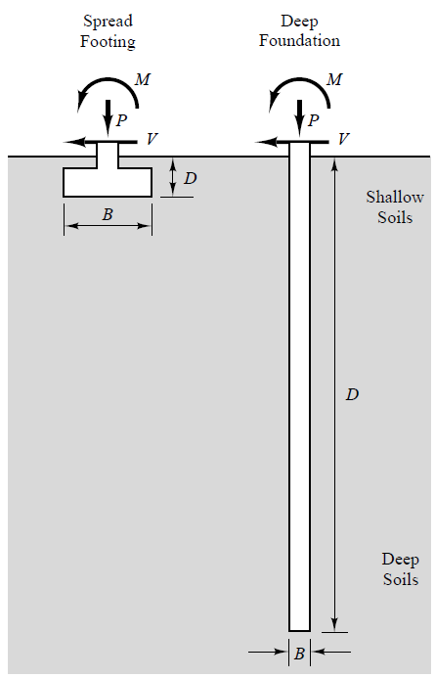
Comparison between a shallow and a deep foundation

Slide 4
Why Deep Foundations?
we prefer to use shallow foundations whenever possible, because they are easier to construct and more economical compared to deep foundations.
but we sometimes need an alternative foundation type:
if the upper soil layers are very weak, or the structural loads are so great that you might need a quite large shallow foundation, which would be uneconomical.
bridge foundations are subjected to scour (erozyon) and undermining (altının oyulması).
piers (iskele), ports and offshore platforms usually require deep foundations that would penetrate through water.

Slide 5
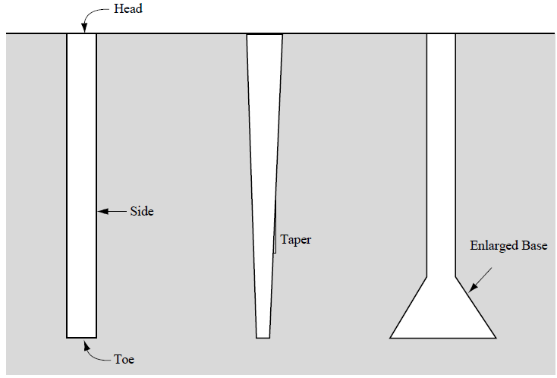
Why Deep Foundations?
if large uplift forces on foundations are present,
if structures and therefore foundations are subjected to large lateral forces.

Slide 6
Pile Types: Timber Piles
piles are made up of three main materials: timber, concrete, steel
timber piles are the oldest type of piles (even Romans have used them):
they are more economical compared to other material types, however their service life is often limited to about to 10 years due to biological reasons.
also their load carrying capacity is less compared to piles by other materails.
they are also susceptible to damage during driving.

Slide 7
Pile Types: Steel Piles
steel piles:
they are used commonly for medium to large loads (depending on the pile section a single pile can typically carry axial load between 300 to 7000 kN).
good for hard driving conditions (e.g. through stiff, dense soils).
easy to splice (uçuca eklemek) by welding when long piles are needed.
driving is noisy and pile sections are expensive.
there are two main sections: H and pipe.

Slide 8
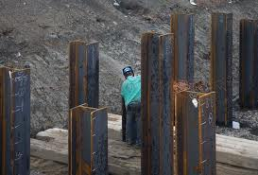
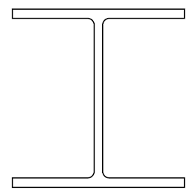
Steel Piles : H section
they are small displacement piles since they displace small volume of soil during driving.
often used as end bearing by driving until the bedrock.
typically 15 to 50m long and have axial load capacity of 350 to 1800 kN.
flange
web

Slide 9
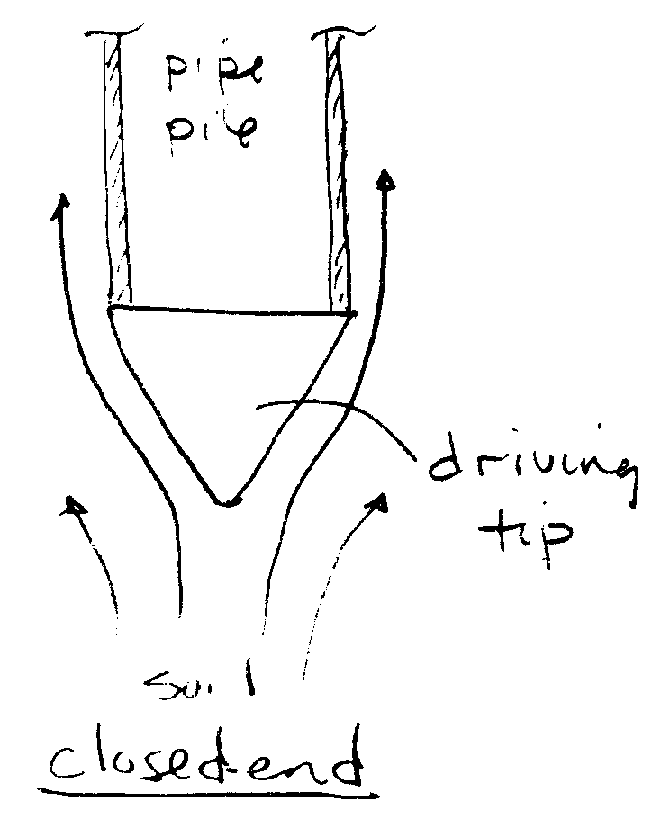
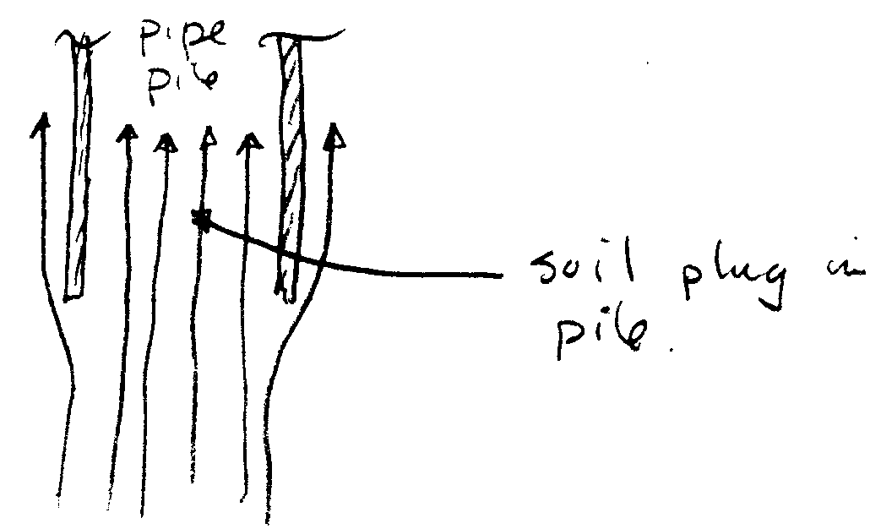
Steel Piles : Pipe Piles
they can be driven either closed end (large displacement for this case) or open end (small displacement piles for this case).
their diameters are typically between 20cm to 100cm (diameters for the offshore platforms can be much larger i.e. 3m).
typically 20 to 50m long and have axial load capacity of 450 to 7000 kN.
they have larger moment of inertia (I) compared to H piles, so better choice for large lateral loads.

Slide 10
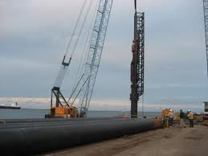
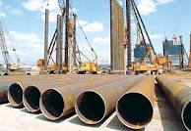
Steel Piles : Pipe Piles
closed end pipe piles have higher axial load capacity but harder to drive compared to open ended pipe piles.

Slide 11
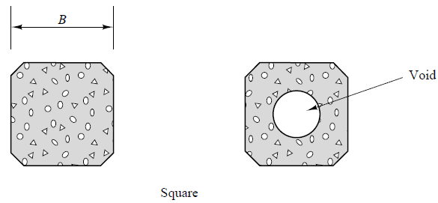
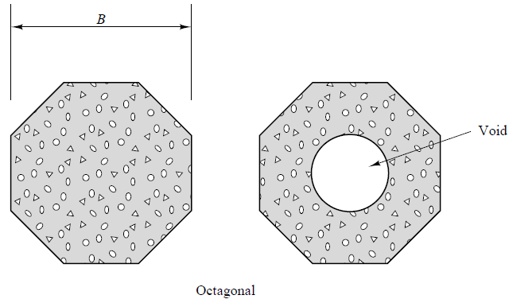
Pile Types: Concrete Piles
concrete piles:
they are precast concrete reinforced members.
usually have square or octagonal cross sections.

Slide 12
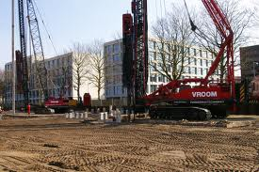
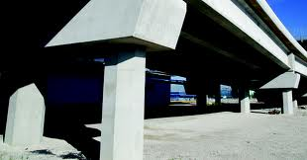
Pile Types: Concrete Piles
their diameters are typically between 25cm to 60cm.
typically 12 to 30m long and have axial load capacity of 450 to 3500 kN.
usually prestressed for increased flexural and tensile strength.
less expensive than steel, also less tolerant of hard driving than steel.

Slide 13
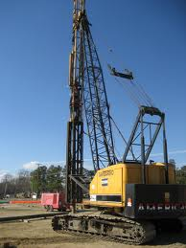
Pile Driving
piles are driven by a pile driver (pile-driving rig), which keep the pile and hammer properly aligned during driving.
hammer is the part of the pile driver which provide repetitive blows with enough energy to drive the pile without breaking it.
there are different types of hammers.

Slide 14
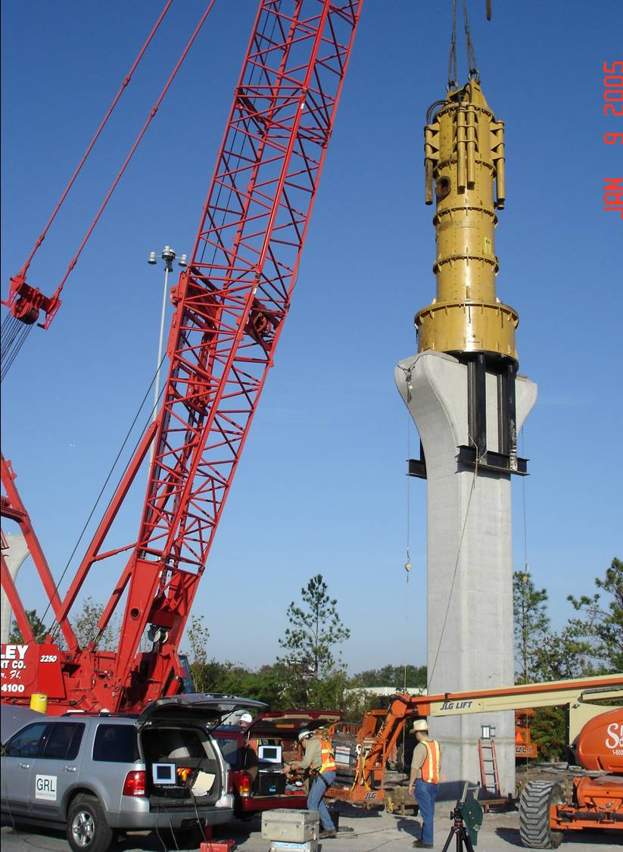
Hammer Types
drop hammers: a weight is raised and then dropped directly on to the pile.
unlike the old days drop hammers are not used as commonly as before.

Slide 15
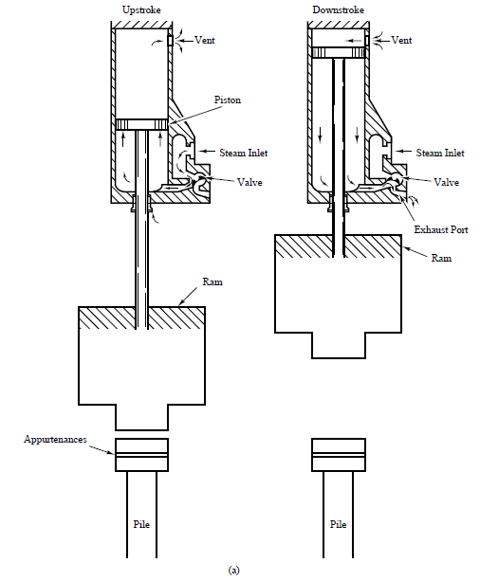
Hammer Types
steam, pneumatic and hydraulic hammers: steam hammers use steam to raise the ram(şahmerdan), while pneumatic hammers use compressed air, hydraulic hammers use hydraulic fluid.

Slide 16
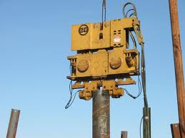
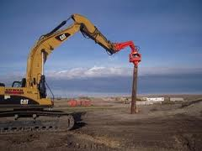
Hammer Types
vibratory hammers: they use rotating eccentric weights to create vertical vibrations (up to 150 Hz).
they work best with piles driven into in sandy soils, does not work in clays or boulder type materials.
they operate quickly and quiter than conventional hammers.

Slide 17
Driving a concrete pile with a vibratory hammer at İskenderun

Slide 18
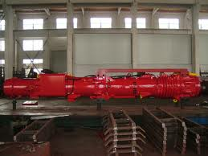
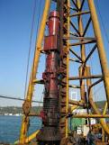
Hammer Types
diesel hammers: they have the same principle with a diesel internal combustion engine.
they work best for hard driving conditions, not so easy to operate in soft conditions.
they are popular but not environmentally friendly.

Slide 19
Methods for hard driving conditions:
Predrilling:
when driving through hard materials, predrilling a hole makes driving the pile afterwards easier.
predrilled hole diameter should be less than the pile diameter to ensure firm contact of the pile with the soil.
Jetting:
jetting is used for very dense sandy or gravelly soils.
in jetting, high pressure water is pumped through a line located at the pile tip. This loosens the soil permitting easy driving of the pile.
jetting is effective in sandy and gravelly soils, but is ineffective in clays.

Slide 20
Use of Pile Groups and Pile Caps
usually pile groups (consisting of 3 or more piles) are used to support a structure instead of a single pile. Because:
pile groups have more load carrying capacity,
safer to support in case of one pile has deficiency,
soil is compressed laterally during driving, so the mobilized side friction is greater than for a single isolated pile.

Slide 21
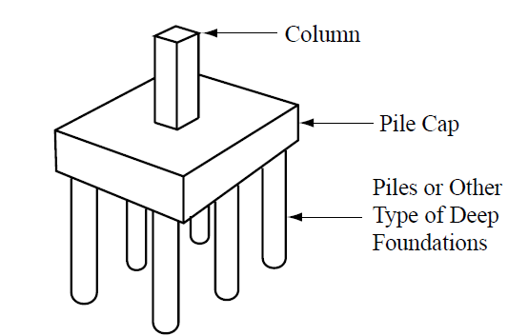
Use of Pile Groups and Pile Caps
each pile in a pile group is connected with a “pile cap”. Pile caps tie the piles to act as a single unit, while redistributing the stresses from possible eccentricities.

Slide 22
Changes in Soil During Pile Driving
unlike shallow foundations, constructing deep foundations change the condition of surrounding soils,
this is because those surounding soils undergo large stresses and strains (e.g. during pile driving, soil around the pile is pushed aside which will cause large lateral stresses).
essentially, the driving process disturbs and fails the soil around the pile. This might substantially (önemli miktarda) change the engineering properties of surrounding soils.
this means that the preconstruction soil tests may not accurately reflect the post-construction soil conditions.

Slide 23
Changes in Clayey Soils
Distortion:
while a pile is driven, the soil within the close vicinity of the pile is dragged down, while the soils within the far vicinity is heaved up.
such distortions are greatest around large displacement piles (e.g. closed end steel pipe piles)

Slide 24
Changes in Clayey Soils
Excess Pore Water Pressures and Consolidation:
in saturated NC clays, large excess pore pressures are generated as a result of pile driving which causes consolidation of such soils in the pile vicinity.
the ratio of excess pore water pressure (u_{e}) to the original vertical effective stress (σ'_{z}) might reach 1.5 to 2 near the pile and gradually diminishes to 0 at an approximate distance of 30 to 40B.
therefore, after driving pile capacity is lower (due to reduced effective stress) until excess pore pressures dissipate.
with time (>1month), the strength regains and maybe higher than the original strength obtained by the lab tests due to consolidation of clay to a lower void ratio (e).

Slide 25
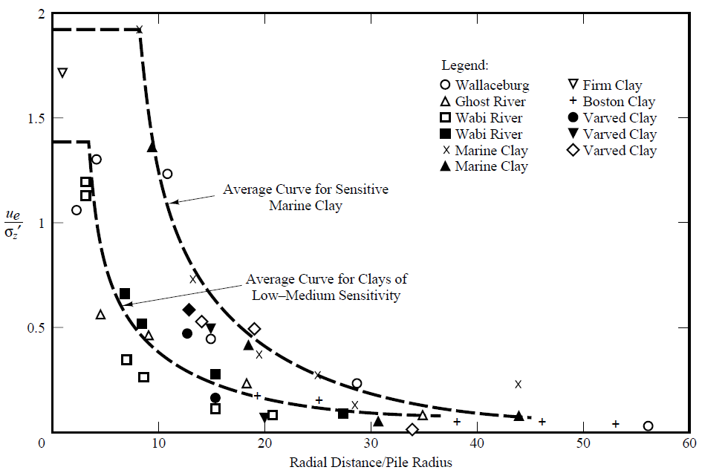
Changes in Clayey Soils
Excess Pore Water Pressures and Consolidation:

Slide 26
Changes in Clayey Soils
Gaps:
during driving the pile head moves about creating gaps between the soil and pile.
such gaps are seen more in stiff clays compared to soft clays and can extend to a depth 8 to 16 pile diameters.
therefore, one can not depend on the skin friction to be mobilized in this region, where there is loss of contact between the pile and surrounding soil.

Slide 27
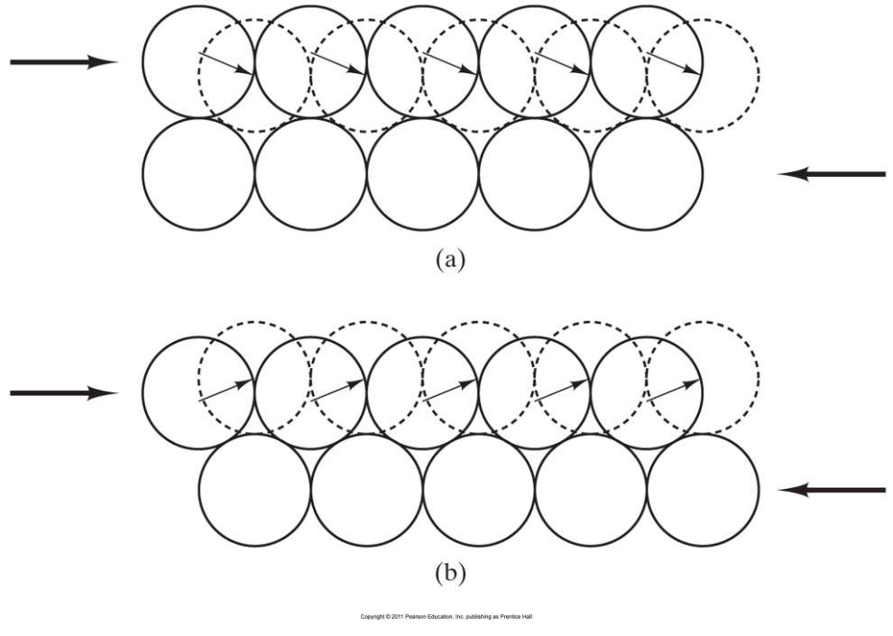
Changes in Sandy Soils during Driving
unlike clayey soils, excess pore pressures generated during pile driving dissipate quickly in sandy soils. WHY?
this rapid dissipation enables to attain the full pile capacity quickly in sandy soils.
loose sands may densify during driving.
Coduto et al. (2011) Figure 12.6 Shear-induced volume change: (a) loose soil tends to contract during shear; (b) dense soil tends to dilate during shear.

Slide 28
Changes in Sandy Soils during Driving
in dense saturated sandy soils, the driving process causing the soil to dilate resulting in negative excess pore pressures.
this suction increases the strength (because of increasing effective stress) of the sandy soil which makes driving more difficult.
in such a case jetting can make driving easier as mentioned before.
Coduto et al. (2011) Figure 12.6 Shear-induced volume change: (a) loose soil tends to contract during shear; (b) dense soil tends to dilate during shear.

Slide 29
Reading Assignment: Read Chapters 11 and 13 in your book.

Slide 30
Load Transfer in Deep Foundations
axial loads applied on deep foundations are transferred to the soil by skin friction and end bearing.

Slide 31
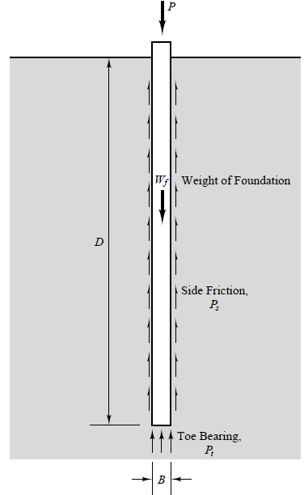
Load transfer in deep foundations
side friction (skin friction) is the resistance along the circumference of the foundation due to the friction and adhesion between the soil and foundation.
toe bearing(tip or end bearing) is the resistance at the bottom of the foundation.

Slide 32
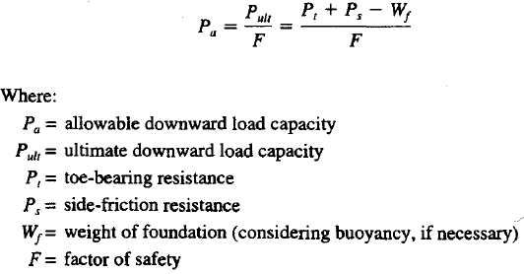
Allowable downward load (P_{a})
the allowable downward load capacity is calculated based on the free body diagram shown in the previous slide.

Slide 33
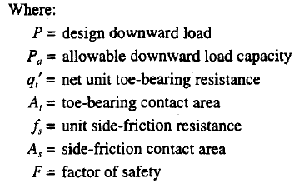
Allowable downward load (P_{a})
the very same formula can be rewritten in terms of unit side resistance and unit toe bearing as follows:
(frictional resistance per unit area)

Slide 34
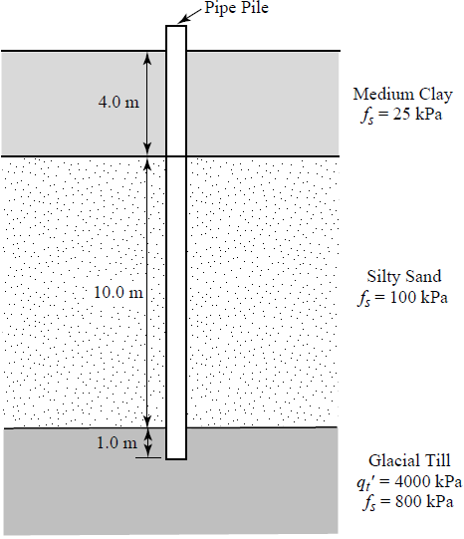
Example 13.1
An 800kN compressive load is to be imposed on a 400mm diameter, 15m long steel pipe pile driven into the soil profile shown in figure. The net unit toe bearing and unit side friction resistances are also shown. Compute the allowable downward load capacity using an F of 3, and determine if the design is acceptable.

Slide 35
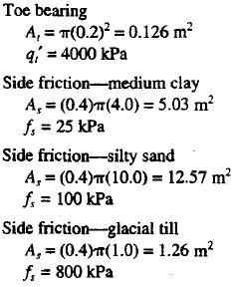
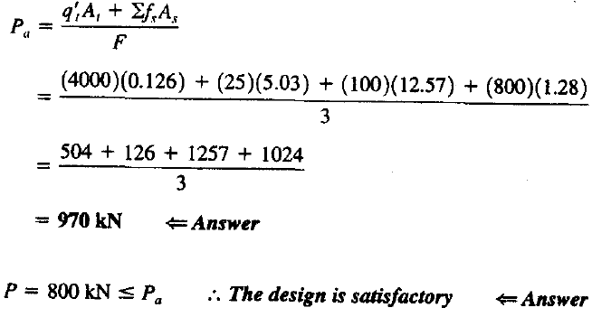
Solution of Example 13.1

Slide 36
Allowable upward load (P_{upward})_{a}
deep foundations resist upward loads by their weights and the side friction (which acts in the opposite direction of downward loading) .
the above equation is valid when D/B>6. Fortunately almost all deep foundations satisfy this condition.

Slide 37
Allowable upward load (P_{upward})_{a}
if some or all of the deep foundation is submerged below the gwt, bouyancy force acting on the submerged section of the foundation should be subtracted from W_{f}.
for upward loading, reduce the total skin friction to 75% of the calculated value to consider the poisson’s effect.
0.75 x...
P_{downward}
P_{upward}

Slide 38
Contact Areas: A_{t} & A_{s}
conventionally A_{t} (toe bearing contact area) is the cross-sectional area of the deep foundation, A_{s} (side friction contact area) is the circumferential area of the deep foundation.
however, for open ended piles (e.g. steel pipe or H piles) calculation of these contact areas is dependent on the plug formation.
as the pile is driven, after a while the soil inside the pile becomes rigidly embedded and starts to act as if it is a section of the pile. This is called “soil plug”.

Slide 39
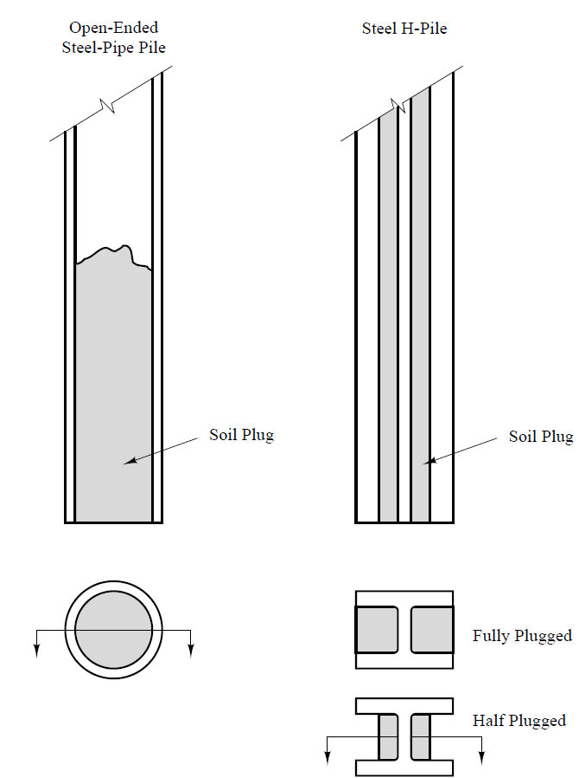
Contact Areas: A_{t} & A_{s}
if plug does not form then assume A_{t} =0, if plug forms use the full cross-sectional area of the deep foundation as A_{t} .
in analyses we usually assume steel H piles are fully plugged so
A_{t} = d.b ,
A_{s} = 2.(d+b).L
L
b
d

Slide 40
How to evaluate axial load capacity of deep foundations?
geotechnical engineers use different ways for evaluating axial load capacity of deep foundations. These are:
static load tests on full scale prototype foundations,
analytic methods that are based on engineering properties of soils obtained by laboratory or in-situ tests,
dynamic methods that are based on the foundation’s response to dynamic loads, such as those from a pile hammer or some other impact source.

Slide 41
Factor of Safety: F or FS
FS for the design of deep foundations depends on many factors including;
spatial variability of the soil profile,
importance of the structure,
type and number of soil tests performed,
availability of on-site static or dynamic load tests,
quality control of construction etc.
greater FS values are used for upward loads, because there are more uncertainties in uplift loading and failures can be sudden and catastrophic.

Slide 42
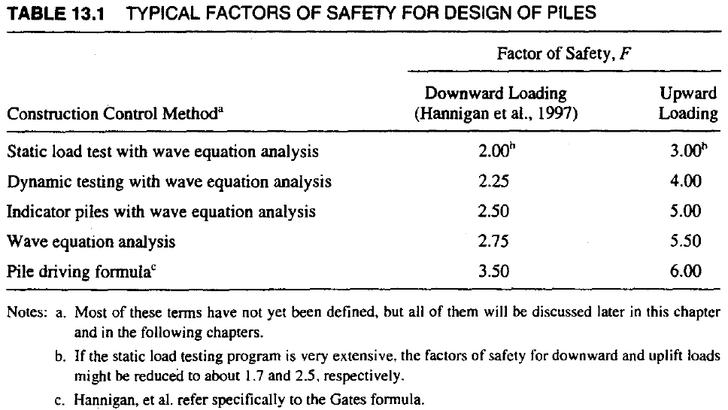
Factor of Safety: F or FS for Piles
remember that the values in the above table are typical values. Greater or smaller values could be used depending on the factors mentioned in the previous slide.

Slide 43
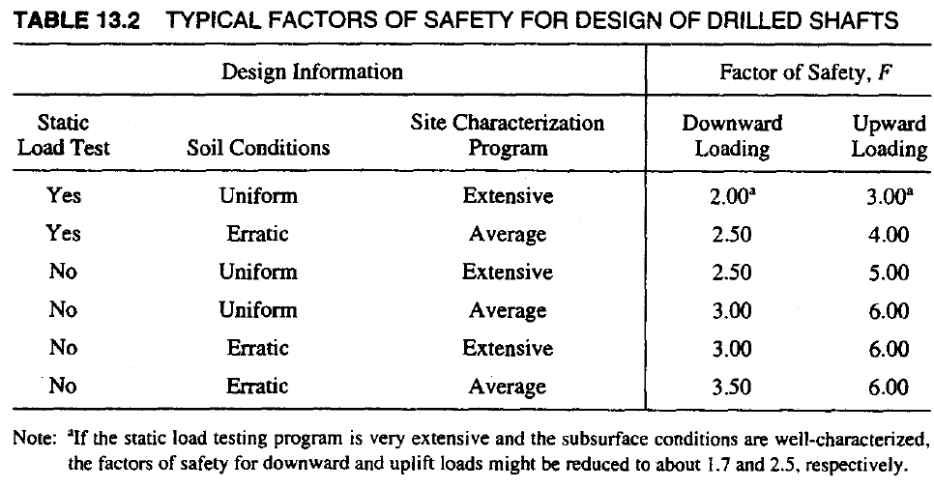
Factor of Safety: F or FS for Drilled Shafts
remember that the values in the above table are typical values. Greater or smaller values could be used depending on the previously mentioned factors.

Slide 44
Static Load Tests
the idea of a static load test is based on slowly loading a full scale prototype foundation on the project site until failure.
in fact this is the most accurate way to learn the ultimate load capacity of a deep foundation, provided that soil and pile conditions will be the same with the test pile and soil conditions.

Slide 45
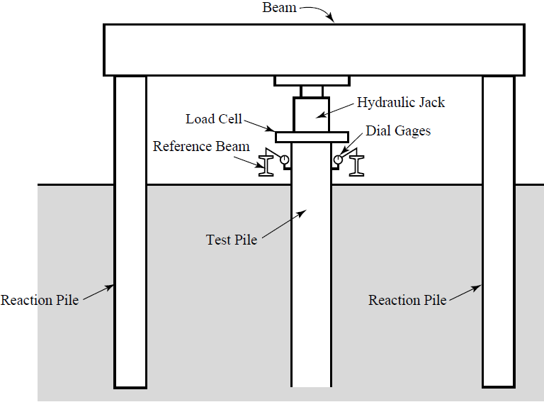
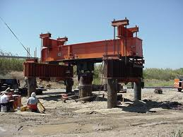
Objective and Equipment of Static Load Tests
the objective of a static load test is to develop a load-settlement curve.

Slide 46
Types of Static Load Tests
two types of static load tests:
Load Controlled: Load increments are applied such that 25%, 50%,.. 200% etc. of the design load, while displacements are measured after a set period of time (2 to 15min) or each load may be hold for 1 to 2 hours, until the foundation stops moving.
Deformation Controlled: Load incements are applied to produce equal increments of displacement.
remember that pile driving could change the surrounding soil conditions and generate excess pore water pressures.
Therefore, it is good to have a delay between the time of driving and testing of piles to allow excess pore pressure dissipation ( this waiting time is about 2 days for sandy soils and at least 30 days for clayey soils).

Slide 47
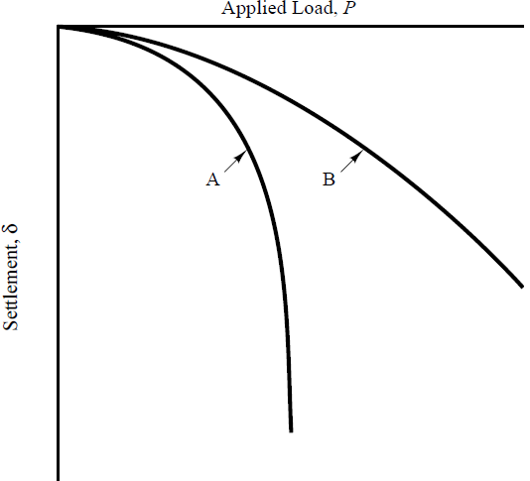
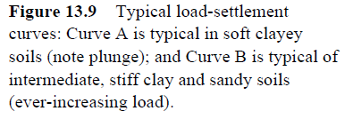
Interpretation of Static Load Test Results
at the end of static load tests we obtain a load-settlement curve, from which we obtain ultimate load capacity of that pile.

Slide 48
Interpretation of Static Load Test Results
ultimate load capacity of a pile in soft clay is relatively easy to determine (i.e. P_{ult}=P_{plunge}).
however for stiff clays, intermediate soils and sandy soils, determination of P_{ult} is not that straightforward.
many different methods have been suggested to determine P_{ult} in such soils, where load settlement curve is like curve B.
Davisson’s method is perhaps the most popular one.

Slide 49
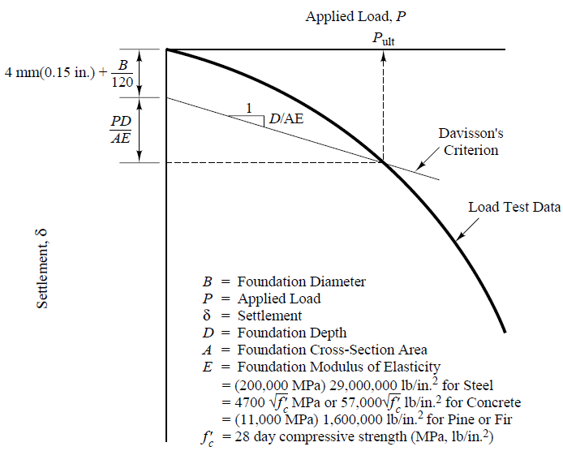
Davisson’s Method

Slide 50
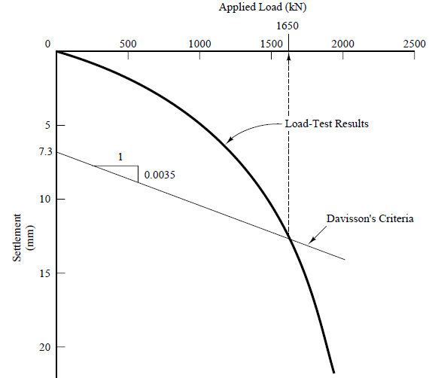
Example 13.3
The load settlement curve shown was obtained from a full-scale static load test on a 400mm square, 17m long concrete pile
(f'c=40MPa).
Use Davisson’s method to compute the ultimate downward load capacity.

Slide 51
Solution of Example 13.3
kN
mm

Slide 52
When to use Static Load Tests
remember that load tests are more precise compared to other methods of ultimate load capacity assessment, hence a less factor of safety is used.
but they are expensive.
if many piles are to be driven, they will most likely reduce the overall construction cost.
they are also important if soil conditions are erratic or unusual to assess the P_{ult}.
they are also performed if structure is important or sensitive to differential settlements.

Slide 53
Axial load capacity of piles based on analytic methods
these methods use soil strength parameters, such as φ'(for sands), Su(for clays), or CPT cone bearing to estimate unit side friction resistance (f_{s}) and net unit toe bearing resistance (q'_{t}).
analytic methods are less expensive than static load tests, however computed axial load capacities might not be as precise.
there are different methods depending on soil type (cohesionless, cohesive) and drainage conditions (drained, undrained)

Slide 54
Toe bearing (end bearing) for piles in cohesionless soils (sands): Vesic/Kulhawy Method
since excess pore pressures generated from pile driving quickly dissipates in sands, drained strength is used.
Vesic/Kulhawy Method is one of the methods used for estimating toe bearing resistance of sandy soils. When D/B≥5, the first term becomes negligible and may be ignored.

Slide 55
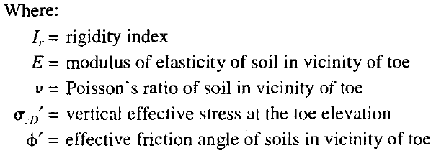
Toe bearing (end bearing) for piles in cohesionless soils (sands): Vesic/Kulhawy Method
remember from CE 441:Foundation Engineering that bearing capacity factors for shallow foundations were functions of shear strength, represented by internal friction angle (φ').
however, bearing capacity factors for deep foundations are functions of both shear strength and compressibility. In order to consider the compressibility influence, a rigidity index (I_{r}) is defined in Vesic/Kulhawy Method.

Slide 56
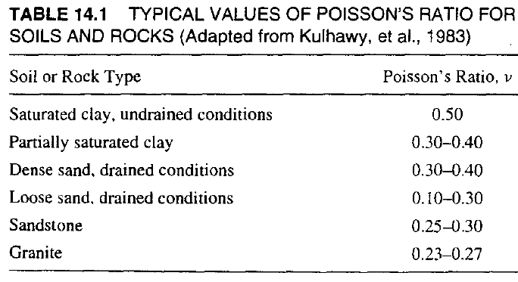
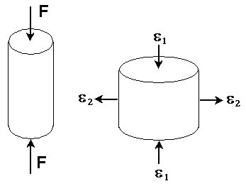
Toe bearing (end bearing) for piles in cohesionless soils (sands): Vesic/Kulhawy Method
the typical magnitudes of I_{r} is between 10-400. Low I_{r} values imply that soil compressibility is important and local or punching shear failure modes govern.
in this method, E is assumed to be very close to the equivalent modulus of elasticity (E_{s}) used in Schmertmann’s method, which uses field test data.
Poisson’s ratio could be obtained from the following table.
ν=−ε₂/ε₁

Slide 57
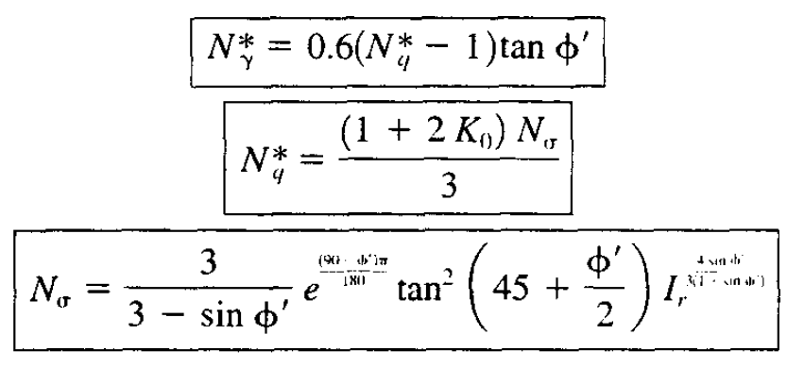
Toe bearing (end bearing) for piles in cohesionless soils (sands): Vesic/Kulhawy Method
Vesic (1977) suggested the following formulas to calculate the bearing capacity factors:
where a=(90-φ')π/180 , b= 4sin φ'/[3.(1+sinφ')]
a
b

Slide 58
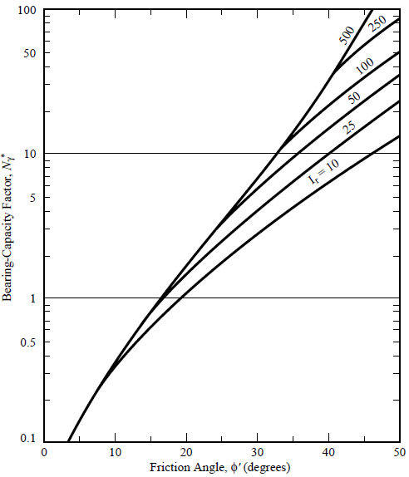
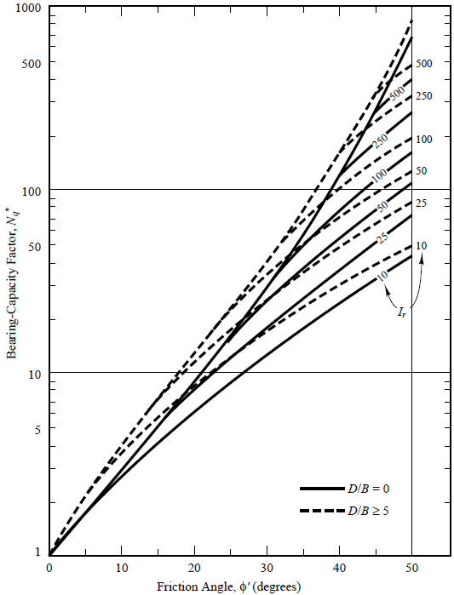
Toe bearing (end bearing) for piles in cohesionless soils (sands): Vesic/Kulhawy Method
alternatively, bearing capacity factors can graphically be obtained.
Figure 14.4
Figure 14.5

Slide 59
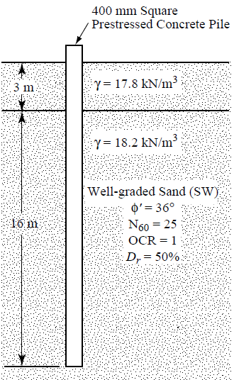
Example 14.1
A 400mm square prestressed concrete pile is to be driven 16m into the soil profile shown in Figure 14.6. Compute the net ultimate toe bearing capacity. (gwt is at 3m depth)
13m

Slide 60
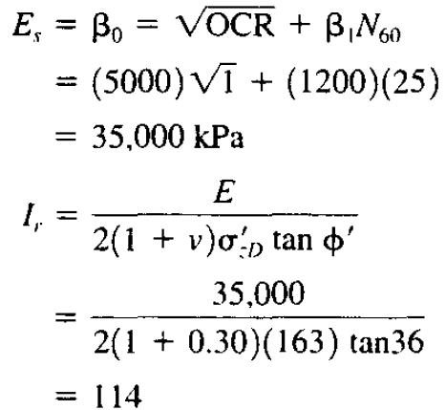
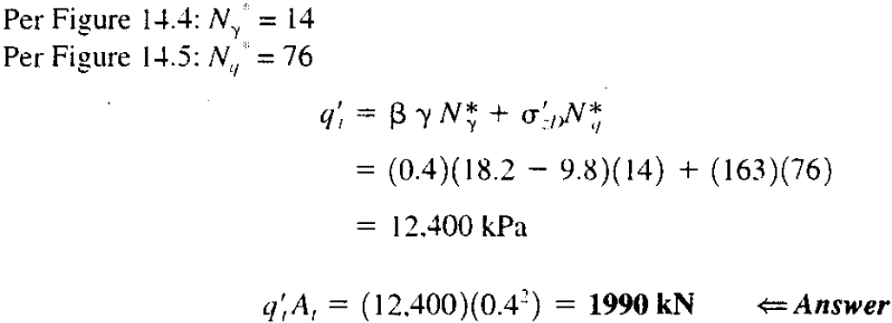
Solution of Example 14.1
B

Slide 61
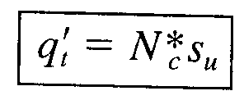
Toe bearing (end bearing) for piles in cohesive soils (clays)
remember that clayey soils have low hydraulic conductivity, hence we assume that undrained conditions prevail in clayey soils.
we use the following equation for piles in clayey soils (when D/B>3 and S_{u}≤250kPa).

Slide 62
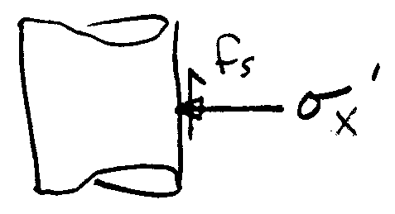
Side friction (skin friction) for piles in cohesionless soils (sands)
estimating side friction is based on principle of simple sliding friction model.
from lab tests, internal friction of sands (φ') is determined, from which φ'_{f} could be obtained by correlations.

Slide 63
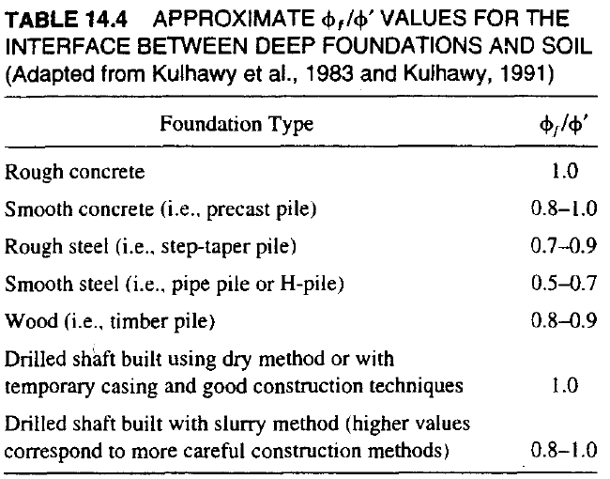
Side friction (skin friction) for piles in cohesionless soils (sands)
from lab tests, internal friction of sands (φ') is determined, from which φ'_{f} could be obtained by correlations.

Slide 64
Side friction (skin friction) for piles in cohesionless soils (sands)
remember the coefficient of lateral earth pressure (K) from CE441 Foundation Engineering.
it is the ratio of horizontal stress to the vertical stress:
remember that construction of deep foundations changes the stress conditions in the vicinity of the foundations. Therefore, K before construction is different than the K after the construction.
pile driving causes compression of the surrounding soils, while drilled shaft construction might cause stress relaxation.

Slide 65
Side friction (skin friction) for piles in cohesionless soils (sands)
K before construction is different than the K after the construction.

Slide 66
Side friction (skin friction) for piles in cohesionless soils (sands): “General Method”
using the following equations that we have seen before,
we obtain the following equation: (σ'_{z} is the vertical effective stress at the midlayer).
f_{s}= σ'_{z} .K_{o} .(K/K_{o}). tan[φ'.(φ_{f} /φ')]
note that Eqn. 14.21 in your book is incorrect.
remember from CE 441: Foundation Engineering that Ko can be obtained by the following formula:

Slide 67
Example 14.2
A 400mm square prestressed concrete pile is to be driven 16m into the soil profile shown in Figure 14.6. Compute the allowable downward capacity of the pile using FS=2.75.
(note that we calculated the toe bearing in Example 14.1).
13m

Slide 68
Solution Example 14.2
Ko=(1-sin 36)=0.412
from table 14.4 choose (φ'_{f} /φ')=0.9 ; table 14.5 choose K/K_{o} = 1
Pa=(1990kN+620.5kN)/2.75= 949.3kN

Slide 69
Side friction (skin friction) for piles in both cohesive and cohesionless soils : β method
the basic formulation of the method is very simple:
where σ'_{z} is the effective overburden stress at the midpoint of each layer.
top 1.5m of the pile is ignored in side friction calculations in clays, because there might not be an effective soil pile contact in clayey soils towards the top of the pile.
note that this method is an effective stress analysis method.

Slide 70
Side friction (skin friction) for piles in both cohesive and cohesionless soils : β method
also note that β method can also be used for cohesionless soils (e.g. non-plastic silts, sands and gravels) as well.
β is a function of soil type and effective internal friction angle. Typical values are shown below.

Slide 71
Side friction (skin friction) for piles in both cohesive and cohesionless soils : β method
Fellenius (1991) suggested the following chart to predict β values.
figure after Hannigan et. al. (1997)

Slide 72
Side friction (skin friction) for piles in cohesive soils (clays): β method
this figure is usually used for OC clays

Slide 73
Side friction (skin friction) for piles in cohesive soils (clays): α method
this is a total stress analysis method, the basic formulation of the method is similar to the β method, however α is used instead of β and Su is used instead of σ'_{z} .
ideally α is estimated using static load tests by using the S_{u} values measured in the laboratory.
such a back calculation allows us to extend the load test results for the design of piles with different diameters or lengths at that specific site.

Slide 74
Side friction (skin friction) for piles in cohesive soils (clays): α method
if we don’t have load tests, charts can be used. But such an approach will not be as precise.
do not forget to ignore the top 1.5m of the pile in side friction calculations, because there might not be an effective soil pile contact in clayey soils towards the top of the pile. (same in β method)

Slide 75
Side friction (skin friction) for piles in cohesive soils (clays): α method
some researchers stated that unit side friction resistance in alpha method is also a function of pile material and depth of embedment (Thomlinson, 1979).
c_{a}=f_{s}
(pürüzlü)
figure after Hannigan et. al. (1997)

Slide 76
Pile capacity based on CPT Results
predicting the axial load capacity of piles from CPT results are attractive because of the similarities between the CPT and the load transfer mechanism in deep foundations.
CPT is essentially a miniature pile load test.
cone tip resistance(q_{c}) is similar to the net unit toe bearing resistance (q'_{t}) in piles, and the cone side friction (f_{sc}) is similar to the unit side friction resistance (f_{s}) in piles.
there are many CPT based methods including Dutch Method, French Method, Meyerhof Method, Tumay and Fakhroo Method, Nottingham and Schmertmann Method, Eslami and Fellenius Method.

Slide 77
Pile capacity based on CPT Results: Eslami and Fellenius Method
we will cover Eslami and Fellenius Method (1997), which is developed using the results of 102 full-scale static load tests together with CPT data.
it is applicaple to any soil type.
for this method, it is better to use a piezocone CPT (CPTU) to measure the pore water pressure near the cone tip during the test.
depending on the details of the used piezocone, the measured cone tip resistance(q_{c}) is corrected to have “corrected cone resistance, q_{T}” . A plot of q_{T} vs depth is provided to the geotechnical engineer.

Slide 78
Pile capacity based on CPT Results: Eslami and Fellenius Method
this method applies an extra correction to “corrected cone resistance, q_{T}” to have effective cone resistance q_{E} .
toe bearing: net unit toe bearing resistance (q'_{t}) is correlated with the effective cone resistance (q_{E}).
(use C_{t}=1 for piles in any soil)

Slide 79
Pile capacity based on CPT Results: Eslami and Fellenius Method
for piles installed through a weak soil and into a dense soil: use the geometric average of the q_{E} values 8B above the pile toe to 4B below the pile toe.
q_{Eg}=[(q_{E})₁. (q_{E})₂ .(q_{E})₃… (q_{E})_{n}]^{1/n}
(note: equation 14.38 in your book is incorrect)
for piles installed through a dense soil and into a weak soil: use the geometric average of the q_{E} values 2B above the pile toe to 4B below the pile toe.

Slide 80
Pile capacity based on CPT Results: Eslami and Fellenius Method
side friction: the following equation is applied to each CPT data to obtain the unit side friction resistance:

Slide 81
Pile capacity based on CPT Results: Eslami and Fellenius Method
note that Cs dependent on the soil type, and remember that there is no soil sampling in CPT.
the following chart can be used to estimate the soil type.
remember that CPT is a continuous profile test,
for hand calculations, we divide the profile into layers based on the CPT results. Then we calculate fs for each layer.
(cone skin friction)

Slide 82
Example 14.6: Eslami and Fellenius Method
a 400mm prestressed concrete pile is to be driven 12m into the soil profile shown. Using the Eslami and Fellenius Method and a FS of 2.5, compute the allowable downward capacity of the pile.
2500kPa

Slide 83
Sln. of Example 14.6
2500kPa

Slide 84
Group effects in piles
so far we have talked about only single piles, but piles are usually installed in groups, because:
pile groups have more load carrying capacity,
safer to support in case of one pile has deficiency,
soil is compressed laterally during driving, so the mobilized side friction is greater than for a single isolated pile.

Slide 85
Group efficiency in piles
the load capacity of a pile group is not necessarily the sum of the individual pile capacities.
the interactions between the piles in a group is called “group efficiency”, which depends on several factors including number, dimensions and spacing of the piles, soil type, direction of the applied load etc.
in order to calculate the downward load capacity of a pile group, a group efficiency factor is involved:

Slide 86
Group efficiency in piles
in block failure, soil between the piles will move down with the piles as the group is loaded.
usually s≥2.5 to 3B
L_{g}
B_{g}

Slide 87
Group efficiency in piles driven in sandy soils
eventhough there had been research on the group efficiency of piles, determining a group efficiency factor still involves many uncertainties.
if no predrilling or jetting is used, and pile spacings are at least 3B, and the group is not underlained by weak soils, use a η value of 1.
try to avoid predrilling or jetting, as they can significantly reduce the load carrying capacity (when predrilling or jetting has been applied you can use η≈0.7 )

Slide 88
Group efficiency in piles driven in sandy soils
if a pile group founded on a firm bearing stratum of limited thickness is underlain by a weak deposit, then P_{ug} is the smaller of the either the sum of the P_{u} of the individual piles, or the group capacity against block failure of an equivalent foundation consisting of the pile group and the enclosed soil mass punching through the underlying weak soil.
pile groups are usually preferred to be installed at s≥3B to minimize installation problems.
the above recommendation is valid for pile groups both in sandy and clayey soils.

Slide 89
Group efficiency in piles driven in clayey soils
if Su<95kPa and the pile cap is not in firm contact with the ground: use η =0.7 for s=3B, use η =1 for s≥6B, for intermediate center to center pile spacings linearly interpolate between these two values,
if Su<95kPa and the pile cap is in firm contact with the ground: use η =1,
if Su≥95kPa, use η =1 regardless of whether or not the cap is on firm contact with the ground, (formula for the first 3 steps): P_{ug}=η.N.P_{u}
compute the group capacity against block failure using the formula on the next slide,
use the lowest of the applicable values from steps 1 to 4.

Slide 90
Group efficiency in piles driven in clayey soils
group capacity against block failure
P_{ug} :ultimate downward load capacity of the group
g
g

Slide 91
The mechanism of block failure in clayey soils
P_{ug} :ultimate downward load capacity of the group
S_{u-soil 1}
D
S_{u-soil 2}
S_{u-soil 3}
B_{g}. L_{g}. S_{u2}. N*_{c}

Slide 92
Example problem on axial load capacity of a pile group in a clayey soil
Compute the ultimate downward load capacity of a pile group in a clayey soil. Piles are open ended steel pipe piles with 400mm diameter, 20m long and 1m center to center spacing. Experiments have shown that Su of the clayey soil is 30kPa. Pile cap is not in firm contact with the ground.
plan view of the pile group

Slide 95
Settlement in Pile Foundations
pile foundations do not usually settle much when properly designed (usually less than 12mm). Such a value is acceptable for most foundations.

Slide 96
Settlement in pile foundations
however engineer could perform settlement analyses for the following cases:
one or more highly compressible strata exist below the toe,
if superstructure is very sensitive to settlements,
if downdrag loads might develop during the life of the structure (read Ch 18.1 for more details in downdrag loads).

Slide 97
Load-Settlement response in pile foundations
the load-settlement response is approximated by the following relationship

Slide 98
Load-Settlement response in pile foundations
there is usually an elastic compression component as well:

Slide 99
Settlement of pile groups: Imaginary Footing Method
in this method, an imaginary footing is assumed to exist at a certain depth.
for friction piles, position the imaginary footing at a depth of z_{i}=0.67D,
for pile groups that mainly rely on toe bearing , position it at depth z_{i}=D.
remember, z_{f} is considered as the distance to the midpoint of different soil layers

Slide 100
Settlement of pile groups: Imaginary Footing Method
once the imaginary footing is positioned, settlement analyses is performed in the same manner with the shallow foundations.
vertical effective stress increase at the midpoint of each layer can be calculated as:
also elastic compression (δ_{e}) is added to the computed settlement using z_{c}=z_{i}

Slide 101
Example problem on settlement of a pile group

Slide 103
Solution of Problem 14.19

Slide 104
Drilled Shaft Foundations
remember that drilled shafts are different than piles, but are another common type of deep foundations.
the fundamental difference is that, piles are driven prefabricated foundations, whereas shafts are drilled and cast-in-place foundations.
most drilled shafts are 50 to 120cm in diameter, and 6 to 25m deep (usually wider, but shorter than piles).

Slide 105
Construction stages of a drilled shaft foundation
about 10cm clearance is left between the rebar-cage and the drilled hole surface .

Slide 106
Construction stages of a drilled shaft foundation

Slide 107
Advantages of drilled shafts over piles
cost for a drill rig are less than a pile driver (more economical interms of equipment).
less noise and vibration (could be important when working in city centers),
during drilling, soils could be observed and even be classified,
diameter or length of the shaft can easily be re-adjusted at the site depending on the unexpected conditions.
foundation can be installed through boulders & cobbles. It is also possible to penetrate many types of bedrock.

Slide 108
Disadvantages of drilled shafts over piles
workmanship and quality of construction is very important on load capacity of shafts.
unit side friction resistance of a shaft is typically less than a pile of comparable dimensions. Because soil is laterally displaced during pile driving, which would increase the lateral stresses, resulting in more side friction.
even so, remember that coefficient of friction (not the unit side friction resistance) is typically higher for drilled shafts than piles because of rougher contact surface between the concrete and soil for shafts.
end bearing may be less because the soil under the tip is not densified like under the tip of a driven pile.
full scale static load tests are more expensive compared to piles, because of the larger capacities of drilled shafts. Typically, indirect correlations with soil properties are used.

Slide 109
Underreamed (Belled) Shafts (ream: genişletmek)
special buckets can create a belled bottom on drilled shafts.
the ratio of the bell (underream) diameter to the shaft is smaller than 3 (i.e. B_{b}/B_{s}≤3).

Slide 110
Underreamed (Belled) Shafts
belled shafts have increased end bearing capacity due to their enlarged bases.
therefore, they are especially useful for deep foundations that primarily rely on end bearing, such as shafts bottomed on strong soils or rock.
also they have greater uplift capacities compared to conventional shafts.
however, displacement to mobilize full end bearing is typically around 10% of B_{b}, which might be larger than the allowed settlement for some structures.
also, the base of the bell should be cleaned of loose soil, before placing concrete. Also bells are suitable for clayey soils only, sandy soils would collapse.
they are not as commonly constructed as conventional straight drilled shafts.

Slide 111
Axial load capacity of drilled shafts based on analytic methods

Slide 112
Toe bearing (end bearing) for drilled shafts in cohesionless soils (sands): O’Neill & Reese Method
this method is developed from instrumented full-scale static load tests. It involves basic emprical formulas using in situ (SPT) test results.
for N₆₀<50

Slide 113
Toe bearing (end bearing) for drilled shafts in cohesionless soils (sands): O’Neill & Reese Method
if B_{b}>120cm, excessive settlements could develop to mobilize full toe bearing resistance.
therefore, unit net toe bearing resistance (q'_{t}) is reduced to a lower value (q'_{tr}) as follows:

Slide 114
Toe bearing (end bearing) for drilled shafts in cohesive soils (clayey soils)
basic equation for the net toe bearing resistance is the same that we used for piles (also remember that undrained conditions govern in clayey soils).
for shafts in clayey soils we use the above equation (when D/B>3 and S_{u}≤250kPa) (if S_{u}>250kPa, material is considered as an intermediate geomaterial between soil and rock and the above eqn. is not valid).

Slide 115
Toe bearing (end bearing) for drilled shafts in cohesive soils (clayey soils)
similar to toe bearing in sandy soils, settlement is a concern for toe bearing of large diameter deep foundations in clayey soils. Therefore, O’Neill and Reese (1999) suggested to reduce the value of q'_{t} to q'_{tr} if B_{b}>190cm.
(B_{b} and D are in meters)
(S_{u} in kPa)

Slide 116
Side friction (skin friction) for drilled shafts in cohesionless soils
β method is used: , where σ'_{z} is the effective overburden stress at the midpoint of each layer.
there are couple of ways to determine the value of β depending on the soil type:
using the general method: β=K_{o} .(K/K_{o}). tan[φ'.(φ_{f} /φ')] for all cohesionless soils,
using O’Neill and Reese (1999) equation for sands
if N₆₀≥15, β=1.5-0.245 √z , where z is depth to the midpoint of soil layer (m),
if N₆₀<15, β= N₆₀/15 x (1.5-0.245 √z)

Slide 117
Side friction (skin friction) for drilled shafts in cohesionless soils
using Rollins et al.(1997) equation for gravely soils
if more than 50% of the grains are gravel: β= 3.4* e^{(-0.085 z)} 0.25 ≤ β ≤ 3
if 25-50% of the grains are gravel: β= 2 - 0.15* z^{0.75}
0.25 ≤ β ≤ 1.8
Fellenius (1999) suggests to use β values between 0.27 and 0.5 for silts

Slide 118
Side friction (skin friction) for drilled shafts in cohesive soils (clayey soils)
similar to the piles in cohesive soils, α method is used for estimating the side friction resistance of drilled shafts in clayey soils.
remember that this is a total stress analysis method,
the values of α can be predicted either from the Kulhawy and Jackson (1989) curve (Fig. 14.14 in your book) or from suggested methodology by O’Neill and Reese (1999) .

Slide 119
Predicting α: Kulhawy and Jackson (1989) curve

Slide 120
Predicting α: O’Neill and Reese (1999) method

Slide 121
Upward load capacity of drilled shafts
remember that when a deep foundation is loaded downward, elastic compression occurs (δ_{e}), which causes a small increase in diameter due to Poisson effect.
however when they are subjected to upward loads, the deep foundation “stretches” and the diameter becomes slightly smaller, which decreases unit side friction resistance (f_{s}) compared to downward loading.
therefore, f_{s} is reduced to 75% of the value for downward loading to be on the conservative side.

Slide 122
FS for drilled shafts
remember that you should consider this table is as a guide, not as a rule.

Slide 123
Settlement in Drilled Shafts
O’Neill and Reese (1999) have developed some charts to estimate the settlement of drilled shafts under service loads.
in these charts, settlement is a function of the ratio of the mobilized resistance to the ultimate resistance.
like many other methods, these charts are also developed from full scale static load tests.

Slide 124
Settlement curve for drilled shafts in clays
considering side friction

Slide 125
Settlement curve for drilled shafts in clays
considering toe(end) resistance

Slide 126
Settlement curve for drilled shafts in sands
considering side friction

Slide 127
Settlement curve for drilled shafts in sands
considering toe(end) resistance

Slide 128
Procedure for settlement analysis (O’Neill and Reese Method) in drilled shafts
calculate the skin friction resistance (P_{s-ult}) and toe bearing resistance (P_{t-ult} or P_{e-ult}) for the drilled shaft.
assume a settlement (δ) and calculate δ/B_{s} for skin friction and δ/B_{b} for end bearing.
go into charts and find (P_{s-mobilized}/ P_{s-ult}) for each layer and (P_{e-mobilized}/ P_{e-ult}).
sum P_{s-mobilized} and P_{e-mobilized} to find P_{total-mobilized} .
if P_{total-mobilized} ≠ P_{design} try new δ (if P_{total-mobilized} >P_{design} reduce δ, otherwise increase it) and repeat the calculations until P_{total-mobilized} ≈ P_{design} .

Slide 129
Example 14.3
The drilled shaft shown in figure is to be designed without the benefit of any onsite static load tests. The soil conditions are uniform and the site characterization program was average. Compute the allowable downward load capacity.

Slide 130
Solution of Example 14.3

Slide 131
Solution of Example 14.3
because N₆₀≥15,
β=1.5-0.245 √z
11.5
0.67
87.7
826.5
Layer thickness = 5.5m, layer thickness = 5m
1736.5

Slide 132
Solution of Example 14.3

Slide 133
Exercise 14.26 (p.556)
Compute the settlement of the shaft in Example 14.3 when it is subjected to the allowable downward load.

Slide 134
Solution of Exercise 14.26

Slide 135
Solution of Exercise 14.26

Slide 136
Solution of Exercise 14.26
you should also add elastic settlement to this value:
δ_{total}=δ+δe= 0.715mm+0.87mm≈1.6mm
assume f'_{c}=40MPa (28 day compressive strength of concrete)
E= 4700*(40)^{0.5}≈30*10³ MPa
= 30*10⁶ kPa
z_{c}= 0.75*14=10.5m

